Slide 1

TOPICS IN MACHINE LEARNING
DEEP REINFORCEMENT LEARNING
PRESENTED BY KHUSHI MEMON & GRAZIA OBUZOR

Slide 2
Contents
Review of key concepts
Review of previous lab work
Rationale for using OpenAI Gym Library
DQN introduction
Implementing DQN

Slide 3
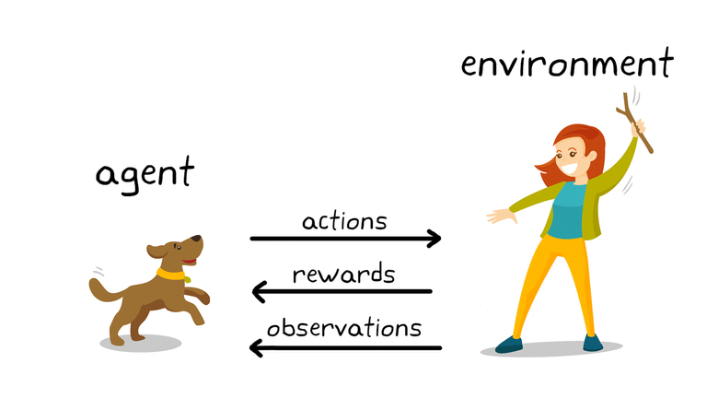
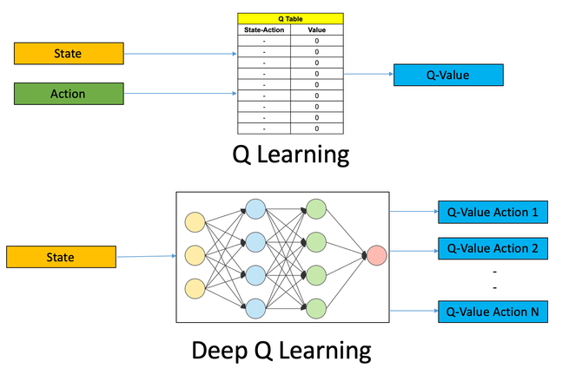
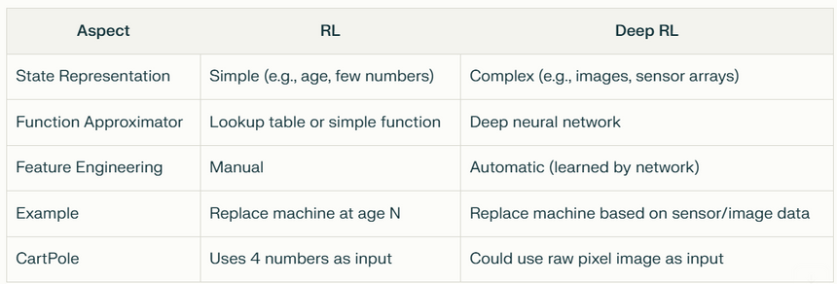
Review of Key Concepts
Definition of RL vs Deep RL
Reinforcement Learning is an ML paradigm where an agent learns through trial and error, by interacting with an environment, receiving feedback (rewards or penalties), aiming to maximise cumulative reward over time (optimal policy). Deep RL uses DNNs to represent the agent’s value function, allowing it to handle complex, high-dimensional, or unstructured input data (such as images or raw sensor data)
Core Framework:
MDP (Markov Decision Process): Mathematical framework (S, A, P, R, γ) where decisions depend only on current state
State (S): Current situation/observation
Action (A): Choice the agent can make
Reward (R): Immediate feedback signal
Cost & Discount Cost (γ): the present value of future costs, calculated using the discount factor γ (gamma).
Episode: Complete sequence from start to terminal state
Policy (π): Strategy mapping states to actions π(a|s) / different to transmission matrices (P)

Slide 4
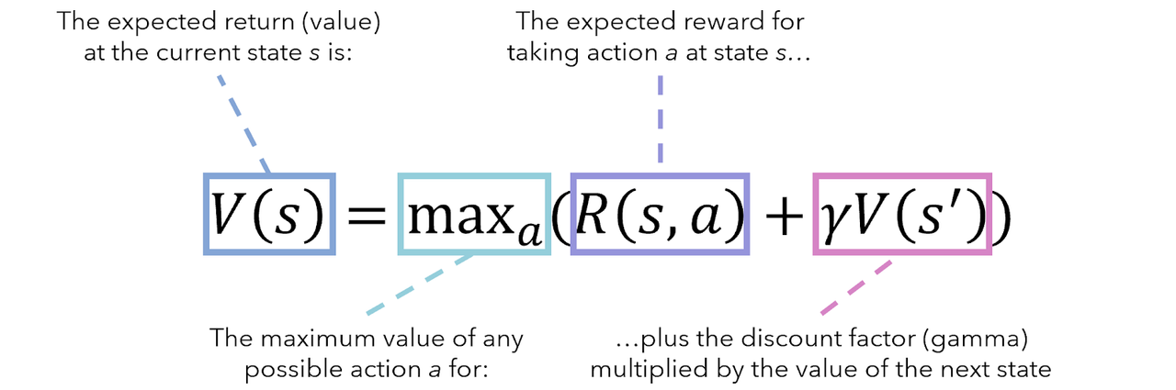
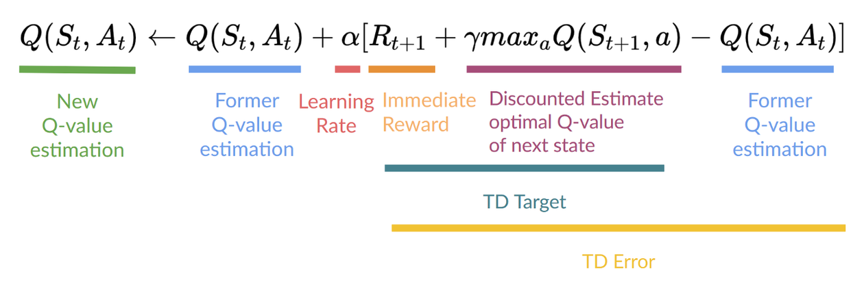
Review of Key Concepts
Value Functions:
V-function: V^π(s) = Expected cumulative reward from state s following policy π (from sum of individual Q-functions)
Q-function: Q^π(s,a) = Expected cumulative reward from state s, taking action a, then following π
Bellman Equations: V(s) = Σ π(a|s)[R(s,a) + γΣ P(s'|s,a)V(s')]

Slide 5
Intro Lab Review
1. Problem Formulation:
Defined the machine replacement scenario as a sequential decision-making problem with states (machine condition/age) and actions (replace or not).
2. Manual Simulation (No Gym):
Implemented a manual simulation of the environment in Python, modelling state transitions, actions, and rewards/costs without using Gym.
3. Policy Definition:
Designed a simple, rule-based policy (e.g., replace if age > threshold) for decision-making.
4. Trajectory Generation:
Ran multiple episodes using the manual simulation and policy, recording state, action, and reward/cost at each step.
5. Discounted Return Calculation:
Calculated the total discounted return (using γ) for each episode to evaluate policy performance.
6. Policy Comparison:
Compared the performance of different policies by analysing their average discounted returns from the manual simulation.
7. Preparation for RL (Gym Integration):
Prepared to transition from manual simulation to using the Gym environment for RL by reviewing state/action space definitions and simulation results.
Notes:
So when it came to training a neural network ourselves we learned that there is a difference between architectural parameters (which are values learned by the model during training and adjusted depending on results from backpropogation to improve its performance – things like the weights and biases of the connections between neurons.) And hyperparameters which are settings that we, as the developers, set before the training process even begins, controlling how the training process itself behaves; with examples including the learning rate, batch size, and the optimizer we choose.
The rationale for exploring these hyperparameters was to learn how to best tune them to achieve the best model performance, efficiency, and training stability for the model we chose: (the PreActResNet model).
Using a training function generated with AI, the main hyperparameters we modified were learning rate, weight decay, and momentum – which control learning speed, overfitting prevention, and learning acceleration, respectively.
We used a trial-and-error approach, where we systematically changed each hyperparameter, one at a time, and observed the effect on performance. To save time, we initially ran short training sessions of just 5 epochs to quickly assess changes. We didn't vary layer number (as there were only 2 layers in the model we obtained); for the optimizer (we stuck to the Stochastic Decent Gradient function discussed in class), and we also didn't use a dropout parameter in this phase.

Slide 6
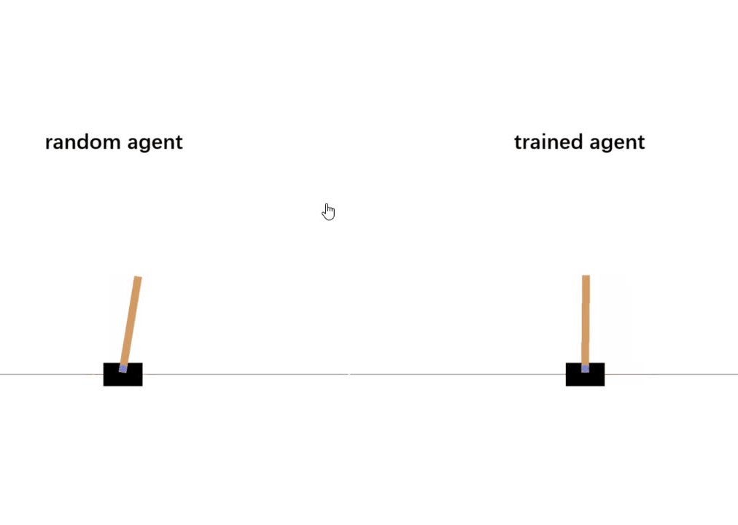
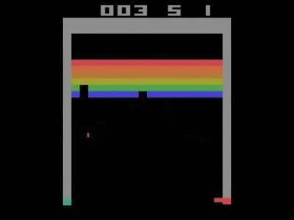
Rationale for using OpenAI Gym Library
Standardised, reproducible RL environments for fair benchmarking [Brockman et al., 2016]
Wide variety of built-in testbeds (classic pole control, Atari, robotics, etc.); as well as our own
Seamless compatibility with PyTorch/TensorFlow with pre-defined functions for faster prototyping deep RL research
Easy visualization with rendering tool, monitoring, and debugging tools
Large community, extensible for custom research tasks

Slide 7
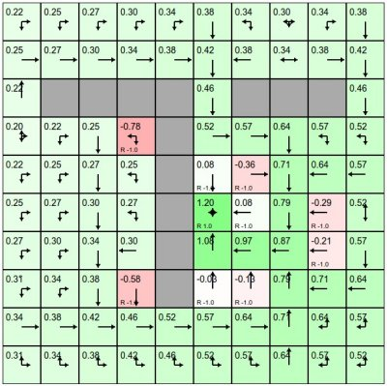
What is Deep Q-Network (DQN)?
Game Screen
DQN = Deep Learning + Q-Learning
Q-learning: Learn a value (Q) for each state-action pair.
Deep CNN: Used to estimate Q-values from pixel inputs.
Key DQN tricks:
Experience Replay (avoid Catastropic forgetting [Kirkpatrick et al., 2017])
Target Network
Reward Clipping
Frame Stacking
REINFORCE Policy Gradient
Convolutional Layers
Fully connected Layers
Q-values for actions
Actions
Notes:
So when it came to training a neural network ourselves we learned that there is a difference between architectural parameters (which are values learned by the model during training and adjusted depending on results from backpropogation to improve its performance – things like the weights and biases of the connections between neurons.) And hyperparameters which are settings that we, as the developers, set before the training process even begins, controlling how the training process itself behaves; with examples including the learning rate, batch size, and the optimizer we choose.
The rationale for exploring these hyperparameters was to learn how to best tune them to achieve the best model performance, efficiency, and training stability for the model we chose: (the PreActResNet model).
Using a training function generated with AI, the main hyperparameters we modified were learning rate, weight decay, and momentum – which control learning speed, overfitting prevention, and learning acceleration, respectively.
We used a trial-and-error approach, where we systematically changed each hyperparameter, one at a time, and observed the effect on performance. To save time, we initially ran short training sessions of just 5 epochs to quickly assess changes. We didn't vary layer number (as there were only 2 layers in the model we obtained); for the optimizer (we stuck to the Stochastic Decent Gradient function discussed in class), and we also didn't use a dropout parameter in this phase.

Slide 8
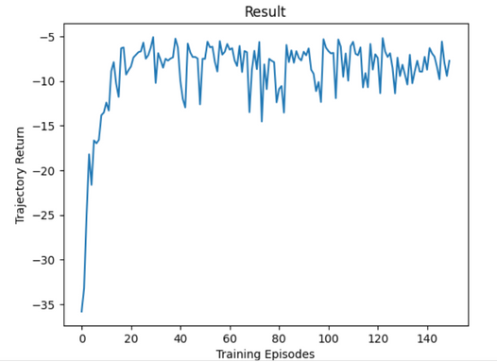
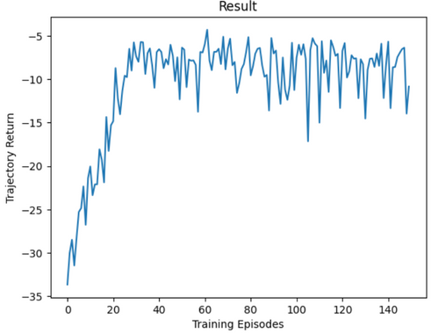
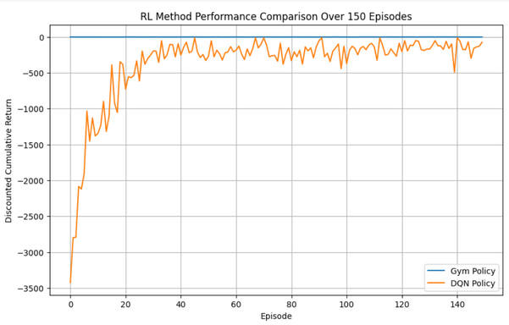
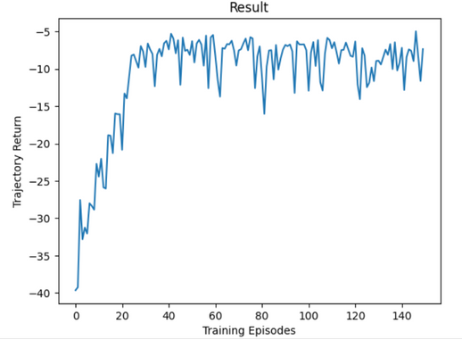
Baseline
DQN Performance Comparison
As an extension of the introductory Lab, we applied our Machine Replacement Environment to a DQN
Varied various parameters to obtain trajectory returns closer to 0 (where only negative values possible)
Ideal : Implement more complex/higher dimension state space (finite action space suitable for DQN)
Explore : DDPG with more complex action space with (learn Q-function and Policy)
*Error: DQN starts at much lower value when compared to the gym environment with no DQN applied
Dropout
> Convolutional Layers
Notes:
So when it came to training a neural network ourselves we learned that there is a difference between architectural parameters (which are values learned by the model during training and adjusted depending on results from backpropogation to improve its performance – things like the weights and biases of the connections between neurons.) And hyperparameters which are settings that we, as the developers, set before the training process even begins, controlling how the training process itself behaves; with examples including the learning rate, batch size, and the optimizer we choose.
The rationale for exploring these hyperparameters was to learn how to best tune them to achieve the best model performance, efficiency, and training stability for the model we chose: (the PreActResNet model).
Using a training function generated with AI, the main hyperparameters we modified were learning rate, weight decay, and momentum – which control learning speed, overfitting prevention, and learning acceleration, respectively.
We used a trial-and-error approach, where we systematically changed each hyperparameter, one at a time, and observed the effect on performance. To save time, we initially ran short training sessions of just 5 epochs to quickly assess changes. We didn't vary layer number (as there were only 2 layers in the model we obtained); for the optimizer (we stuck to the Stochastic Decent Gradient function discussed in class), and we also didn't use a dropout parameter in this phase.

Slide 9
DEEP REINFORCEMENT LEARNING FOR ATARI BREAKOUT USING DQN
A PROJECT EXPLORING PRETRAINED AGENT EVALUATION AND RL WORKFLOWS

Slide 10
Motivation and Problem Statement
Project Goal
Evaluate a Deep Q-Network (DQN) agent's ability to play Atari Breakout using
Pretrained models from Hugging Face
Stable-Baselines3 for standard DQN implementation
Why Breakout?
Classic benchmark in RL research (DeepMind's 2015 paper)
Visually intuitive and easy to demonstrate
Pre-integrated into popular RL libraries like gym, making it accessible for reproducible experiments
Notes:
So when it came to training a neural network ourselves we learned that there is a difference between architectural parameters (which are values learned by the model during training and adjusted depending on results from backpropogation to improve its performance – things like the weights and biases of the connections between neurons.) And hyperparameters which are settings that we, as the developers, set before the training process even begins, controlling how the training process itself behaves; with examples including the learning rate, batch size, and the optimizer we choose.
The rationale for exploring these hyperparameters was to learn how to best tune them to achieve the best model performance, efficiency, and training stability for the model we chose: (the PreActResNet model).
Using a training function generated with AI, the main hyperparameters we modified were learning rate, weight decay, and momentum – which control learning speed, overfitting prevention, and learning acceleration, respectively.
We used a trial-and-error approach, where we systematically changed each hyperparameter, one at a time, and observed the effect on performance. To save time, we initially ran short training sessions of just 5 epochs to quickly assess changes. We didn't vary layer number (as there were only 2 layers in the model we obtained); for the optimizer (we stuck to the Stochastic Decent Gradient function discussed in class), and we also didn't use a dropout parameter in this phase.

Slide 11
Tools and Libraries
gym: provides atari breakout environment
stable-baselines3: implements DQN agent using CnnPolicy
wrap_deepmind: Applies standard preprocessing (grayscale, resize, frame stack)
huggingface_sb3: Load pretrained DQN agents
VecVideoRecorder: Records agent gameplay as video
Matplotlib, OpenCV: For plots and visualizations
Notes:
So when it came to training a neural network ourselves we learned that there is a difference between architectural parameters (which are values learned by the model during training and adjusted depending on results from backpropogation to improve its performance – things like the weights and biases of the connections between neurons.) And hyperparameters which are settings that we, as the developers, set before the training process even begins, controlling how the training process itself behaves; with examples including the learning rate, batch size, and the optimizer we choose.
The rationale for exploring these hyperparameters was to learn how to best tune them to achieve the best model performance, efficiency, and training stability for the model we chose: (the PreActResNet model).
Using a training function generated with AI, the main hyperparameters we modified were learning rate, weight decay, and momentum – which control learning speed, overfitting prevention, and learning acceleration, respectively.
We used a trial-and-error approach, where we systematically changed each hyperparameter, one at a time, and observed the effect on performance. To save time, we initially ran short training sessions of just 5 epochs to quickly assess changes. We didn't vary layer number (as there were only 2 layers in the model we obtained); for the optimizer (we stuck to the Stochastic Decent Gradient function discussed in class), and we also didn't use a dropout parameter in this phase.

Slide 12
DQN Algorithm Overview
Step-by-step Process:
Start with random weights in CNN
Agent plays game, stores transitions in replay buffer
Sample from buffer → train CNN to predict Q-values
Use epsilon-greedy strategy to balance exploration vs. exploitation
Slowly update a separate target network for stability
Notes:
So when it came to training a neural network ourselves we learned that there is a difference between architectural parameters (which are values learned by the model during training and adjusted depending on results from backpropogation to improve its performance – things like the weights and biases of the connections between neurons.) And hyperparameters which are settings that we, as the developers, set before the training process even begins, controlling how the training process itself behaves; with examples including the learning rate, batch size, and the optimizer we choose.
The rationale for exploring these hyperparameters was to learn how to best tune them to achieve the best model performance, efficiency, and training stability for the model we chose: (the PreActResNet model).
Using a training function generated with AI, the main hyperparameters we modified were learning rate, weight decay, and momentum – which control learning speed, overfitting prevention, and learning acceleration, respectively.
We used a trial-and-error approach, where we systematically changed each hyperparameter, one at a time, and observed the effect on performance. To save time, we initially ran short training sessions of just 5 epochs to quickly assess changes. We didn't vary layer number (as there were only 2 layers in the model we obtained); for the optimizer (we stuck to the Stochastic Decent Gradient function discussed in class), and we also didn't use a dropout parameter in this phase.

Slide 13
Implementation Plan
Plan A: Train a DQN agent on Breakout (short run with clipped rewards)
✅ Plan B: Use a pretrained agent (HuggingFace)
(we chose this due to time constraints)
Evaluate performance:
Plot episode rewards
Record agent playing game
Discuss key parameters (gamma, epsilon, learning rate)
Notes:
So when it came to training a neural network ourselves we learned that there is a difference between architectural parameters (which are values learned by the model during training and adjusted depending on results from backpropogation to improve its performance – things like the weights and biases of the connections between neurons.) And hyperparameters which are settings that we, as the developers, set before the training process even begins, controlling how the training process itself behaves; with examples including the learning rate, batch size, and the optimizer we choose.
The rationale for exploring these hyperparameters was to learn how to best tune them to achieve the best model performance, efficiency, and training stability for the model we chose: (the PreActResNet model).
Using a training function generated with AI, the main hyperparameters we modified were learning rate, weight decay, and momentum – which control learning speed, overfitting prevention, and learning acceleration, respectively.
We used a trial-and-error approach, where we systematically changed each hyperparameter, one at a time, and observed the effect on performance. To save time, we initially ran short training sessions of just 5 epochs to quickly assess changes. We didn't vary layer number (as there were only 2 layers in the model we obtained); for the optimizer (we stuck to the Stochastic Decent Gradient function discussed in class), and we also didn't use a dropout parameter in this phase.

Slide 14
Implementation Plan
Stage 1: Environment Setup
gym.make("BreakoutNoFrameskip-v4")
Wrapped with wrap_deepmind() to standardize inputs
Stage 2: Agent Setup
Load DQN using load_from_hub() from Hugging Face
Use CnnPolicy to process raw frames
Stage 3: Evaluation
Run a few episodes, collect rewards
Record gameplay using VecVideoRecorder
Plot cumulative rewards (planned using matplotlib)
Notes:
So when it came to training a neural network ourselves we learned that there is a difference between architectural parameters (which are values learned by the model during training and adjusted depending on results from backpropogation to improve its performance – things like the weights and biases of the connections between neurons.) And hyperparameters which are settings that we, as the developers, set before the training process even begins, controlling how the training process itself behaves; with examples including the learning rate, batch size, and the optimizer we choose.
The rationale for exploring these hyperparameters was to learn how to best tune them to achieve the best model performance, efficiency, and training stability for the model we chose: (the PreActResNet model).
Using a training function generated with AI, the main hyperparameters we modified were learning rate, weight decay, and momentum – which control learning speed, overfitting prevention, and learning acceleration, respectively.
We used a trial-and-error approach, where we systematically changed each hyperparameter, one at a time, and observed the effect on performance. To save time, we initially ran short training sessions of just 5 epochs to quickly assess changes. We didn't vary layer number (as there were only 2 layers in the model we obtained); for the optimizer (we stuck to the Stochastic Decent Gradient function discussed in class), and we also didn't use a dropout parameter in this phase.

Slide 15
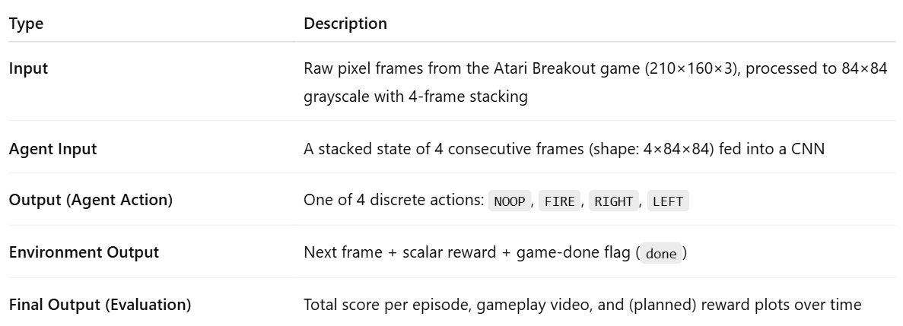
Inputs and outputs
Notes:
So when it came to training a neural network ourselves we learned that there is a difference between architectural parameters (which are values learned by the model during training and adjusted depending on results from backpropogation to improve its performance – things like the weights and biases of the connections between neurons.) And hyperparameters which are settings that we, as the developers, set before the training process even begins, controlling how the training process itself behaves; with examples including the learning rate, batch size, and the optimizer we choose.
The rationale for exploring these hyperparameters was to learn how to best tune them to achieve the best model performance, efficiency, and training stability for the model we chose: (the PreActResNet model).
Using a training function generated with AI, the main hyperparameters we modified were learning rate, weight decay, and momentum – which control learning speed, overfitting prevention, and learning acceleration, respectively.
We used a trial-and-error approach, where we systematically changed each hyperparameter, one at a time, and observed the effect on performance. To save time, we initially ran short training sessions of just 5 epochs to quickly assess changes. We didn't vary layer number (as there were only 2 layers in the model we obtained); for the optimizer (we stuck to the Stochastic Decent Gradient function discussed in class), and we also didn't use a dropout parameter in this phase.

Slide 16
I was not able to get the code running due to time constraints
i was not able to complete setting up the environment but
What i would have done if i had more time
Complete the evaluation code and run episodes
Record gameplay video
Plot reward curves and training stats
Experiment with:
Custom DQN hyperparameters
Fine-tuning on top of the pretrained model
Notes:
So when it came to training a neural network ourselves we learned that there is a difference between architectural parameters (which are values learned by the model during training and adjusted depending on results from backpropogation to improve its performance – things like the weights and biases of the connections between neurons.) And hyperparameters which are settings that we, as the developers, set before the training process even begins, controlling how the training process itself behaves; with examples including the learning rate, batch size, and the optimizer we choose.
The rationale for exploring these hyperparameters was to learn how to best tune them to achieve the best model performance, efficiency, and training stability for the model we chose: (the PreActResNet model).
Using a training function generated with AI, the main hyperparameters we modified were learning rate, weight decay, and momentum – which control learning speed, overfitting prevention, and learning acceleration, respectively.
We used a trial-and-error approach, where we systematically changed each hyperparameter, one at a time, and observed the effect on performance. To save time, we initially ran short training sessions of just 5 epochs to quickly assess changes. We didn't vary layer number (as there were only 2 layers in the model we obtained); for the optimizer (we stuck to the Stochastic Decent Gradient function discussed in class), and we also didn't use a dropout parameter in this phase.

Slide 17
Thank you very much!
ANY QUESTIONS?

